Slide 1
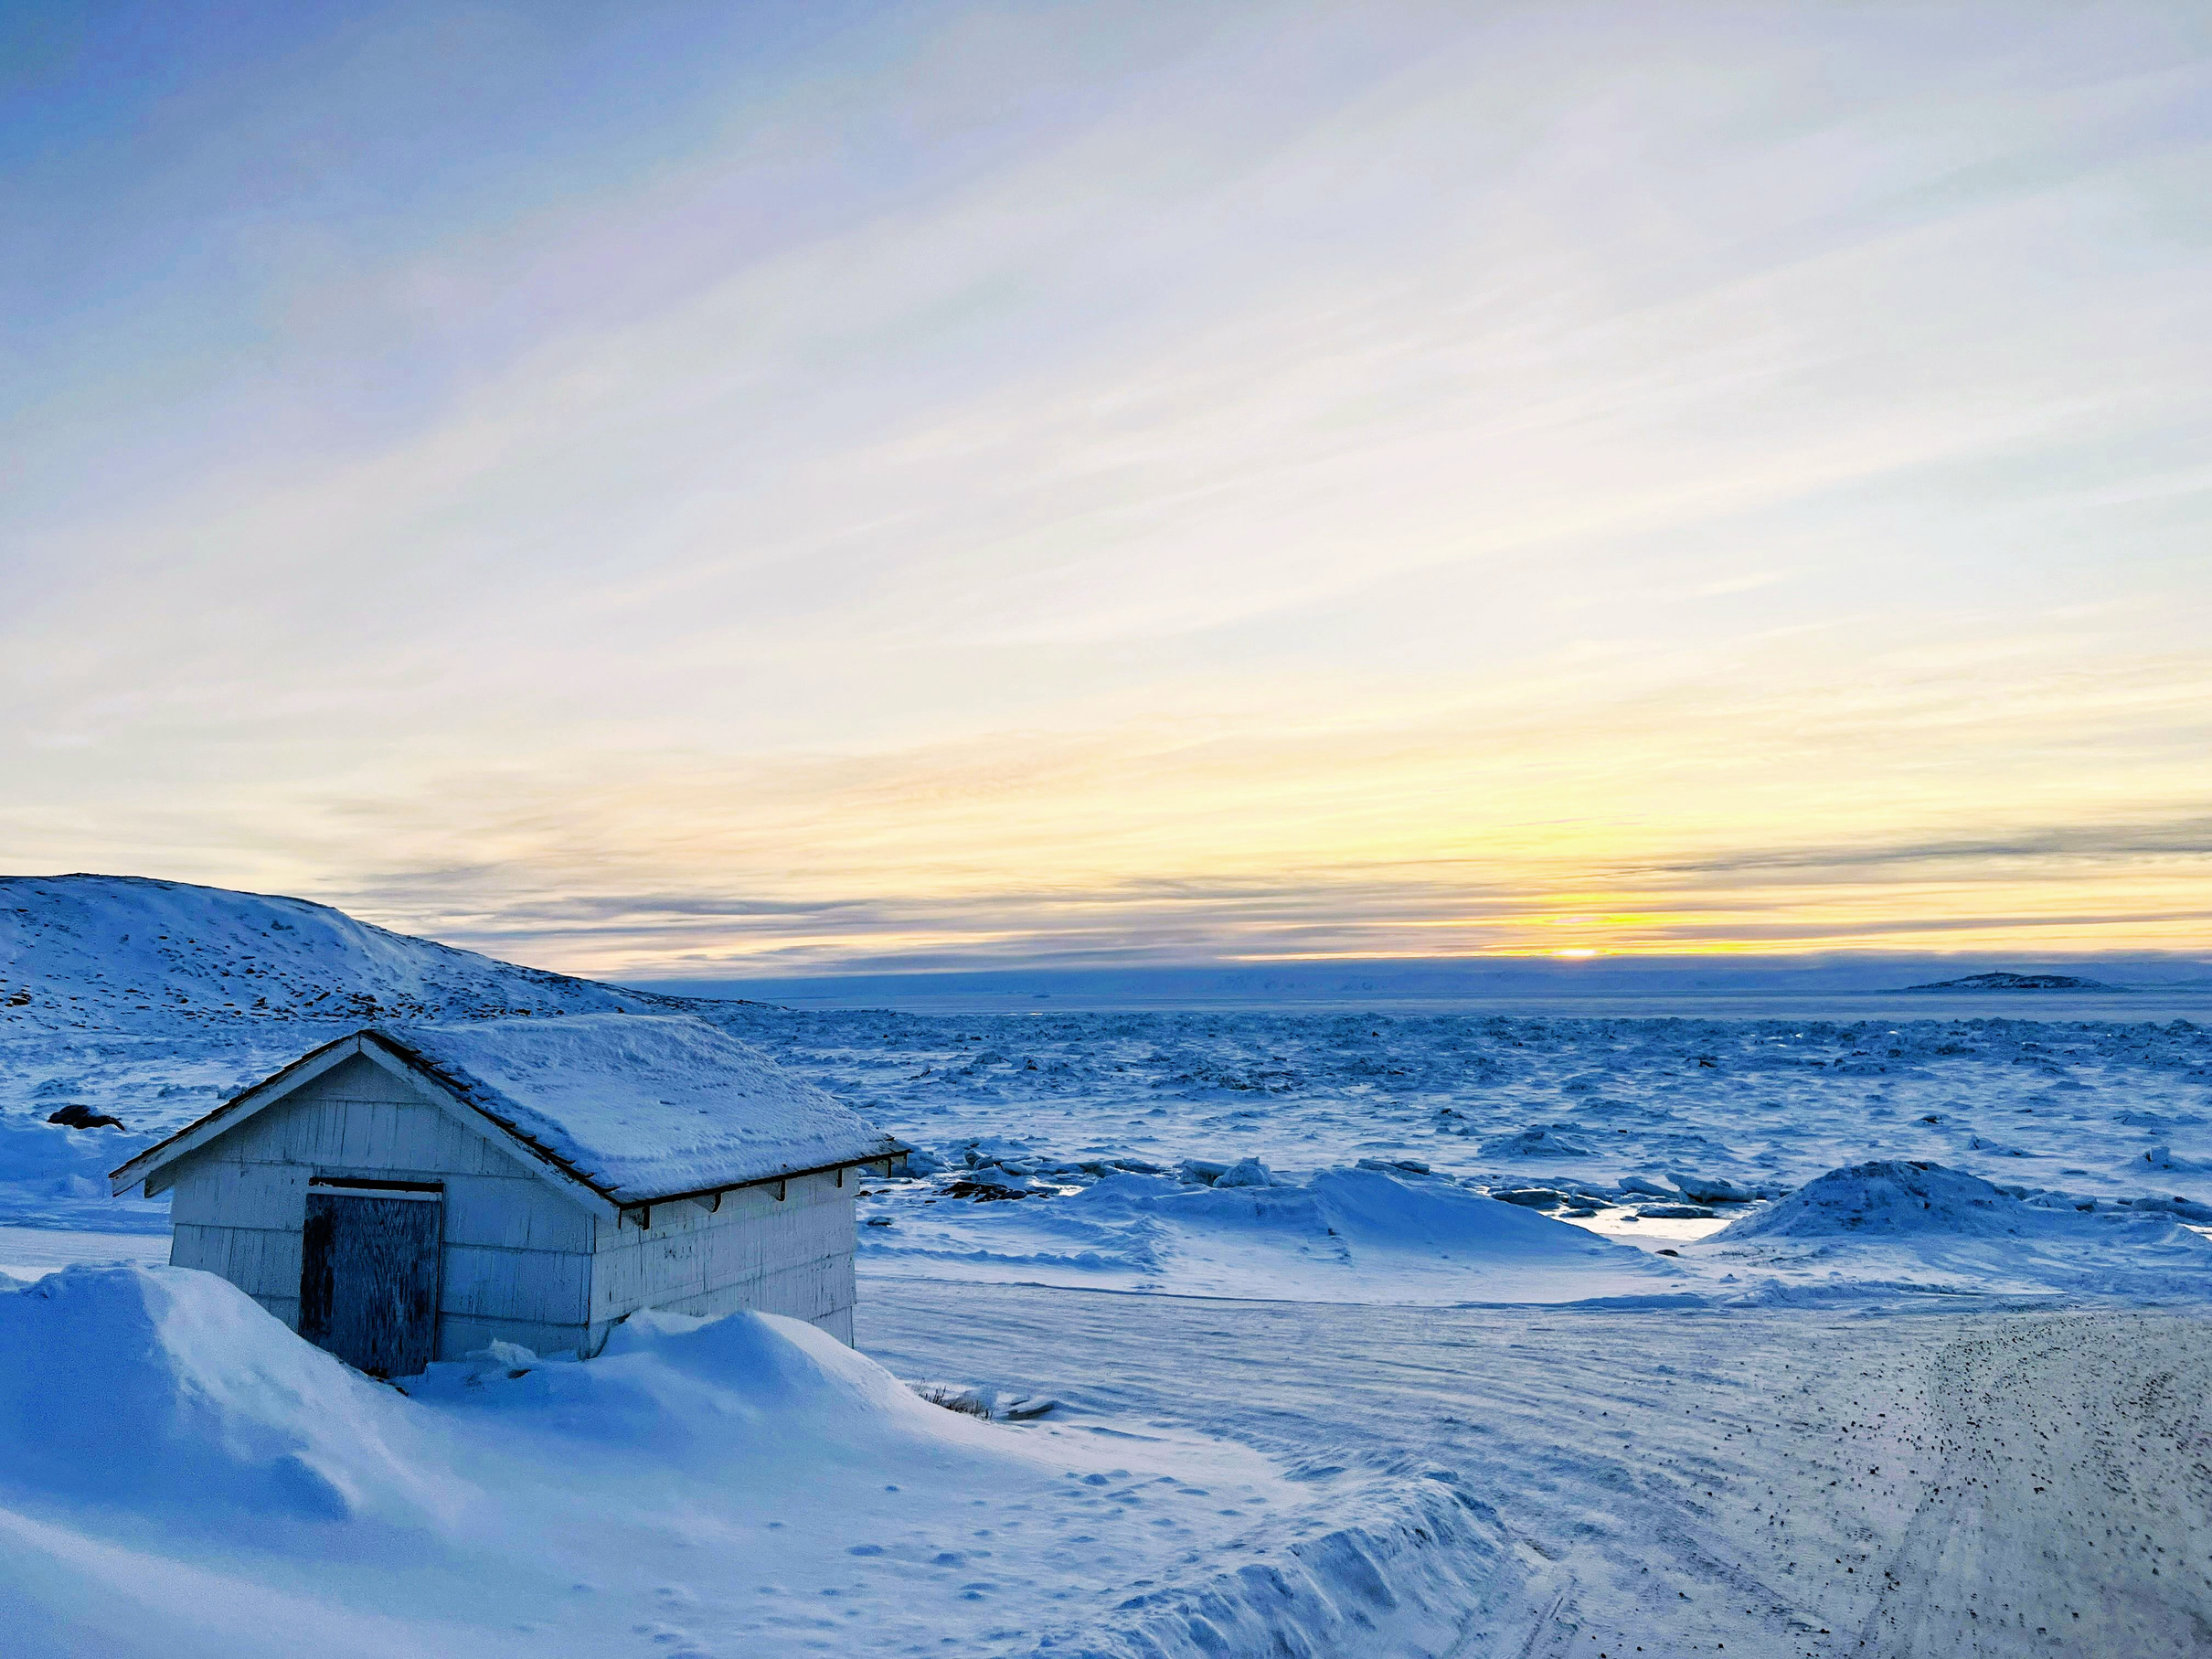

LIFE IN THE FREEZERS
by Moss

Slide 2

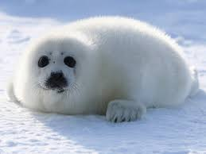
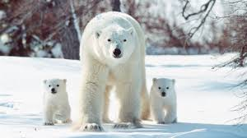
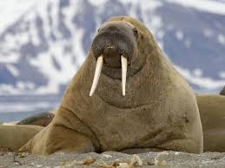
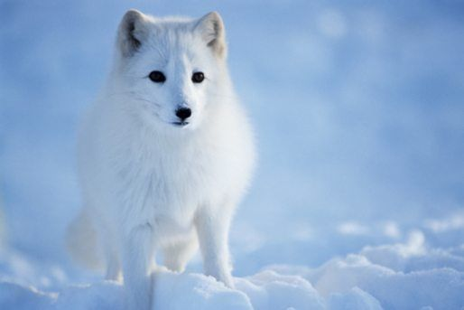
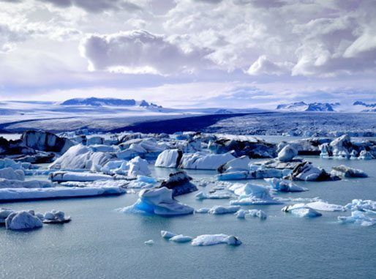
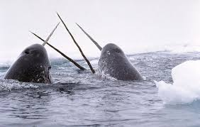
The Arctic has lots of cool (get It) wildlife, including polar bears, Arctic foxes, walruses, seals and whales!
The Arctic
The Arctic is made up of the Arctic Ocean and parts of Canada, Russia, the USA, Greenland, Norway, Finland, Sweden and last but not least Iceland.
Since the Earth tilts, at least one day a year there’s an entire day of darkness brrr. And also a full day of sunshine. Wow!
One of most interesting species found in the Arctic is the narwhal, often referred to as the sea unicorn. Why? Well, male narwhals have a big tusk coming from the front of their head that can grow to over 3m in length!
The Arctic is located at the top of our planet. Scientists usually say the Arctic is a area above the ‘Arctic Circle’ an imaginary line that is around the top of the world.

Slide 3
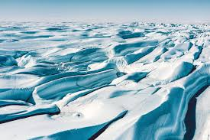
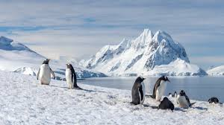
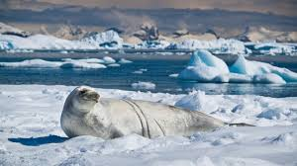
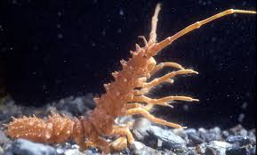
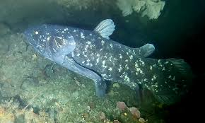
Fragile but strong, Antarctica’s mighty landscapes and teeming wildlife colonies.
The Antarctics most known animal is sure to be the penguin. these cute fuzzy little flightless birds are well adapted but, not very adaptable.
The Antarctic
In Antarctica you can find coelacanths. A rare fish, thought to have lived in their current form for 400 million years ago!!
Microbes close to the surface of the Southern Ocean help with the polar food chain — impacting the food flow from the surface to the depths where other animals thrive in the dark.
Glassy waterways and elusive wildlife with rare sightings await those fortunate enough to travel to Antarctica.

Slide 4
scan this to play a homemade game

